Slide 3
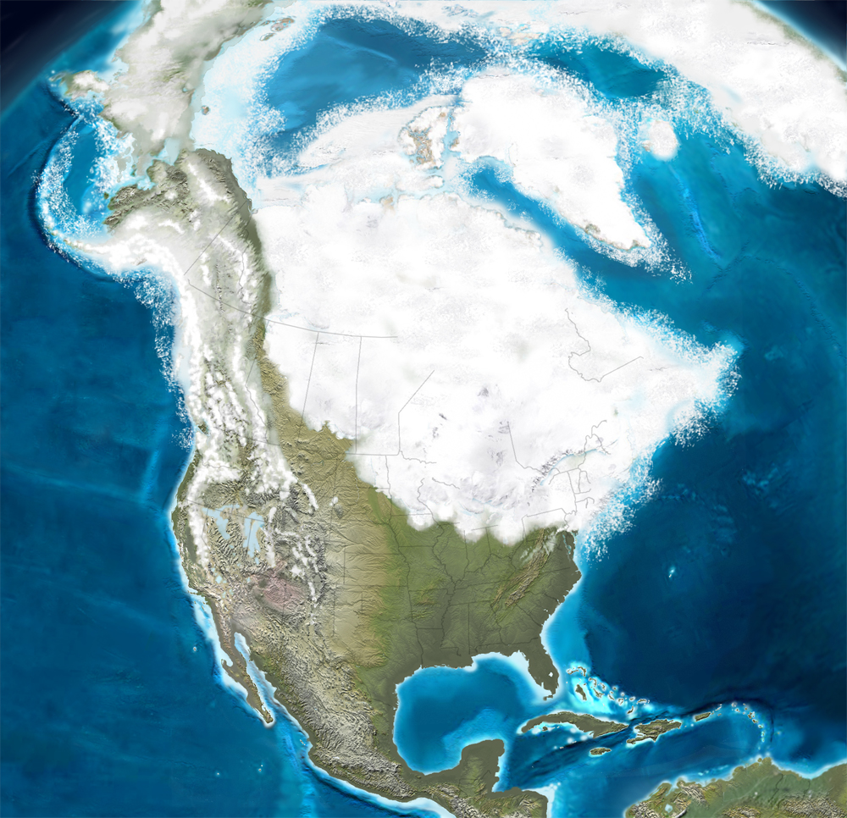

Slide 4
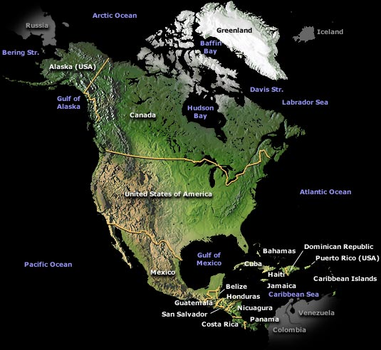

Slide 5
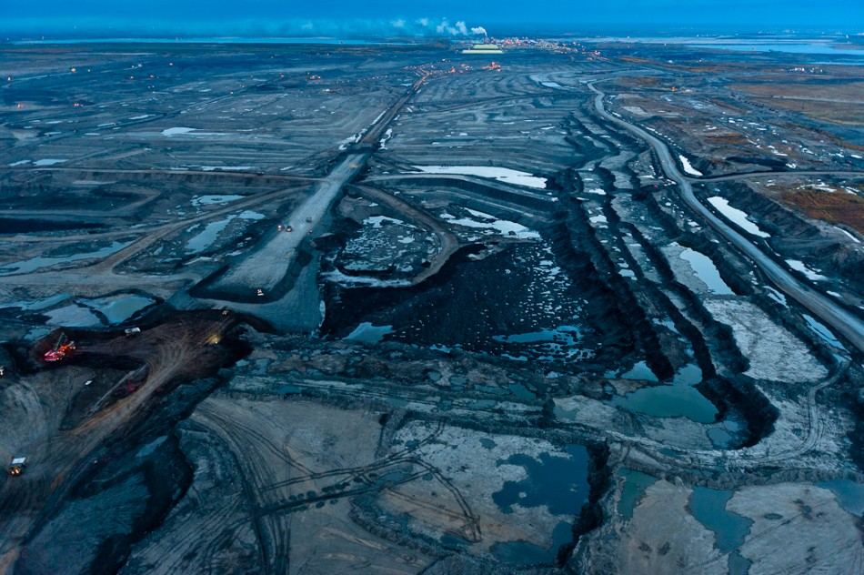

Slide 6
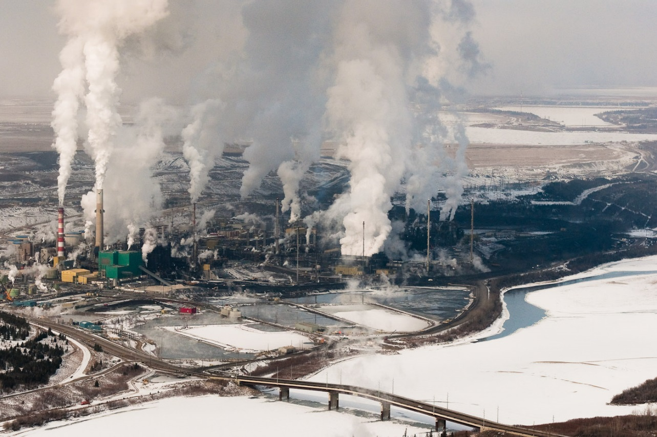

Slide 7
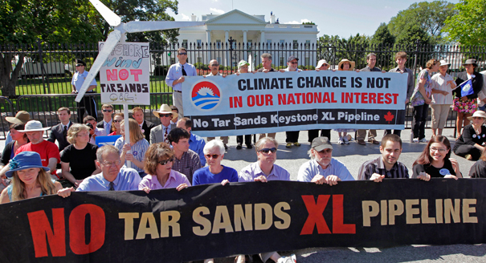

Slide 8
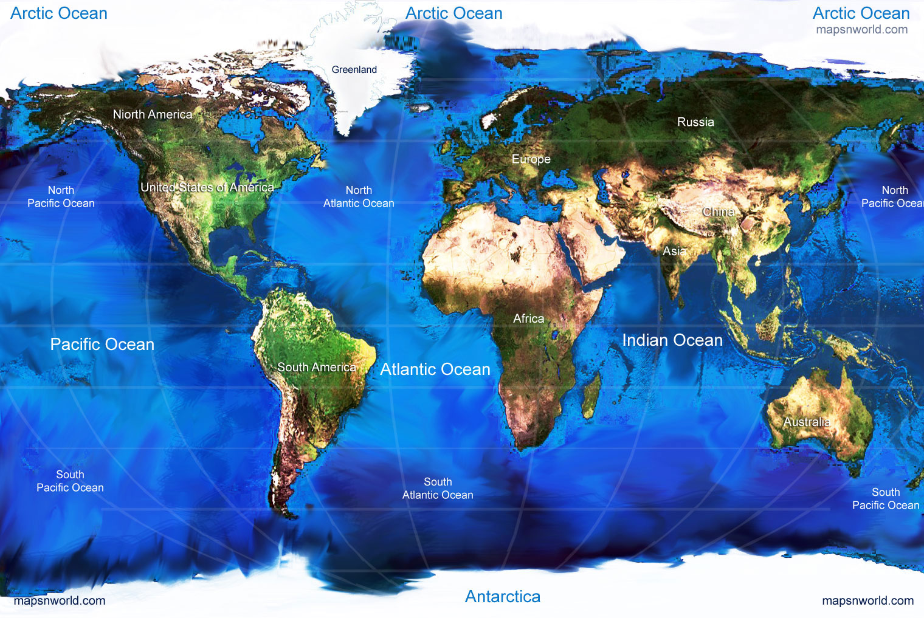

Slide 9
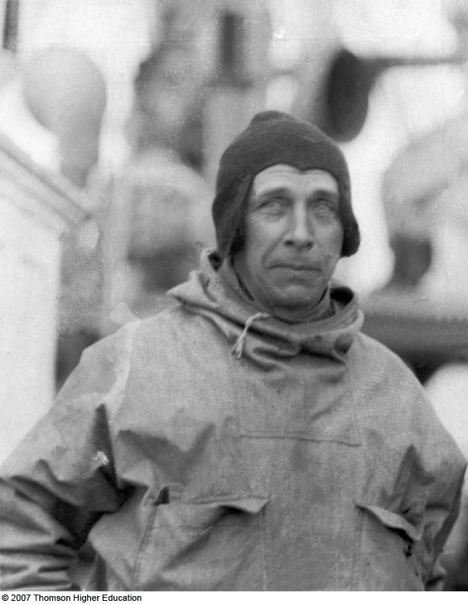
Notes:
Figure 3.11: Alfred Lothar Wegener aboard his expedition ship at the beginning of what would be his last expedition in Greenland in 1930. His remarkable book The Origin of Continents and Oceans was published in 1915. In it, he outlined interdisciplinary evidence for his theory of continental drift.

Slide 10
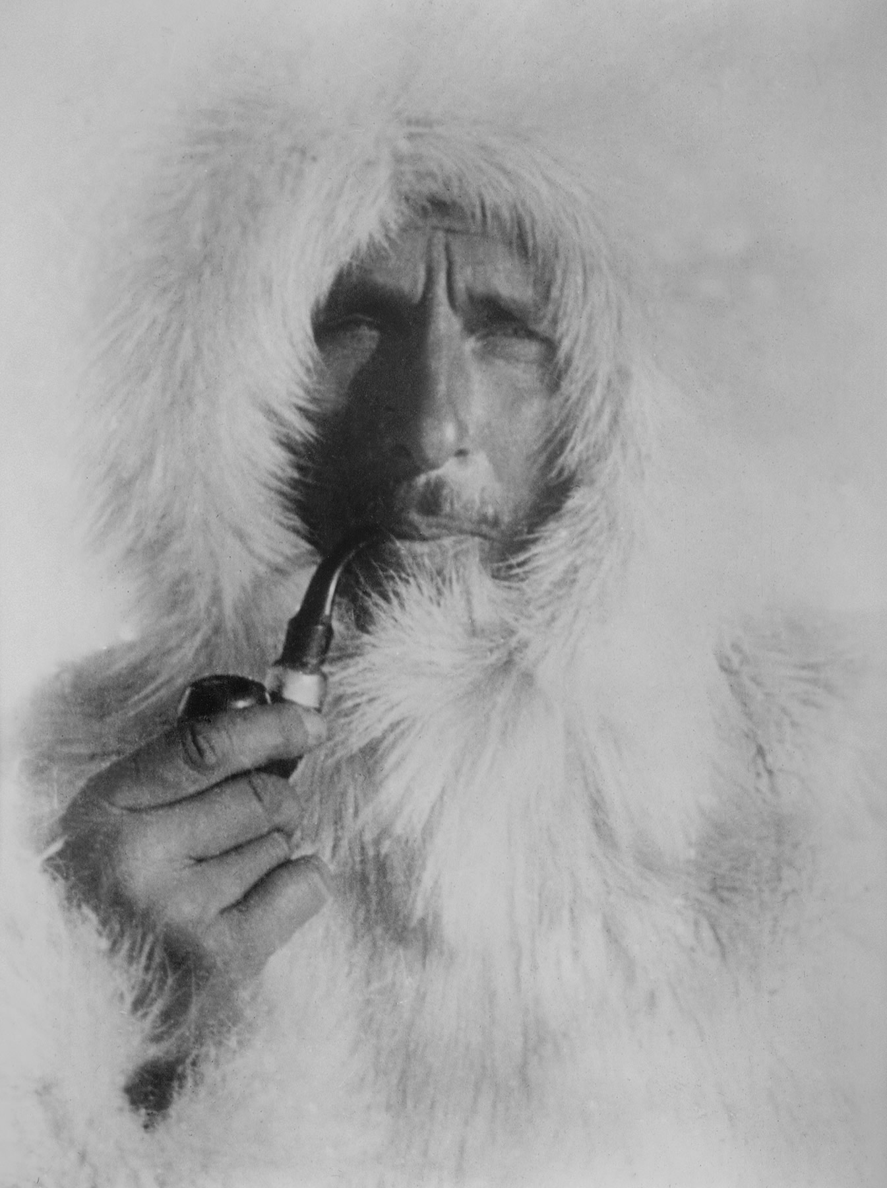
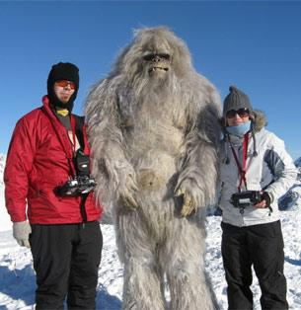

Slide 11
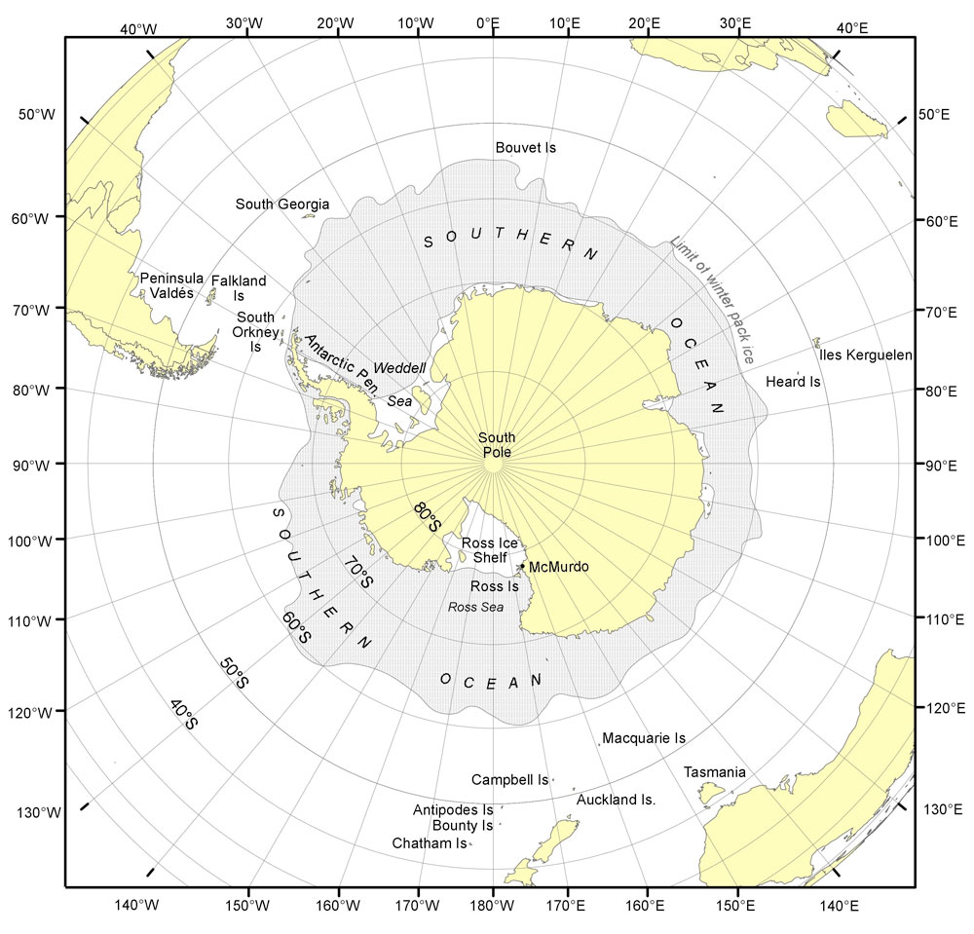

Slide 13
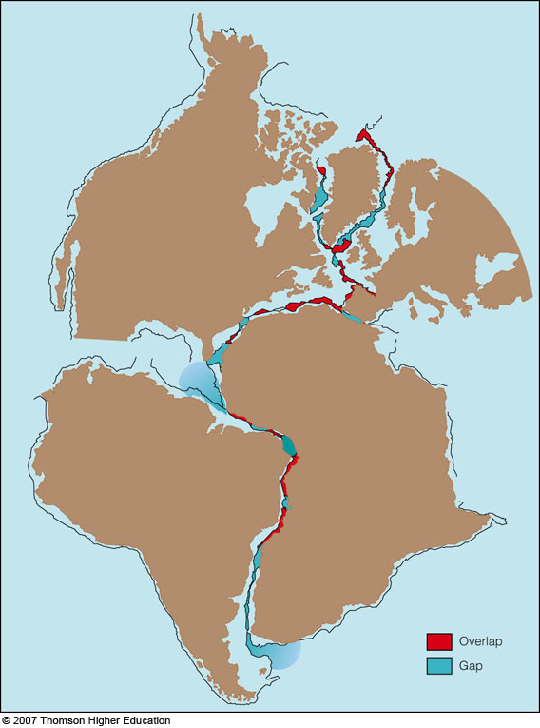
Fig. 3-2, p. 64
Notes:
Figure 3.10: The fit of all the continents around the Atlantic at a water depth of about 137 meters (450 feet), as calculated by Sir Edward Bullard at the University of Cambridge in the 1960s. This graphic was an effective stimulus to the tectonic revolution.

Slide 14
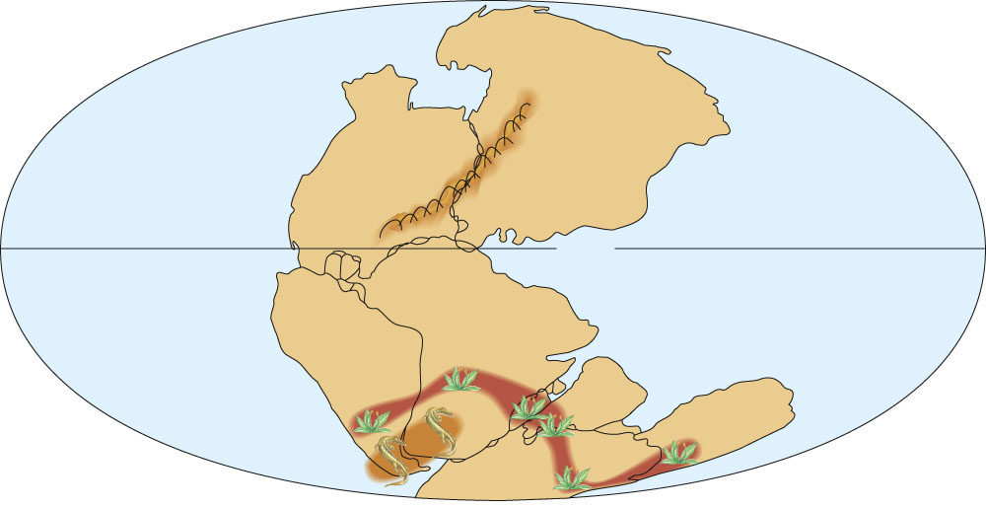
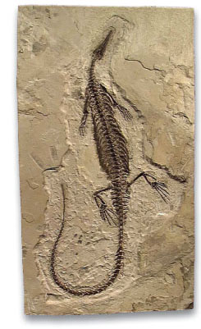
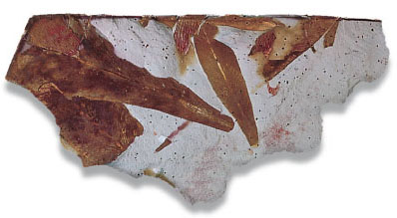
Eurasia
North
America
Tethys
Sea
South
America
Africa
India
Australia
Antarctica
Wegener noted that fossils of Mesosaurus were found in Argentina and Africa but nowhere else in the world
Fossil ferns, Glossopteris, were found in all the southern land masses
Fig. 3-4, p. 65
Figure 3-3 p69

Slide 15
Figure 15.5

Slide 16
Fig. 3-4, p. 65
Figure 3-3 p69

Slide 17
Figure 15.7

Slide 18
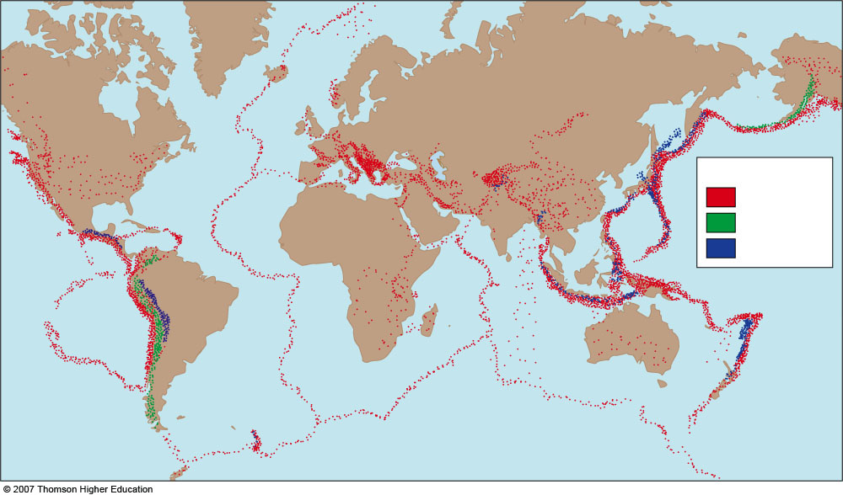
Depth of Earthquakes
0–70 km
70–300 km
> 300 km
Fig. 3-14, p. 84
Fig. 3-16, p. 78
Notes:
Figure 3.14: Seismic events worldwide, January 1977 through December 1986. The locations of about 10,000 earthquakes are colored red, green, and blue to represent event depths of 0–70 kilometers, 70–300 kilometers, and below 300 kilometers, respectively.

Slide 19
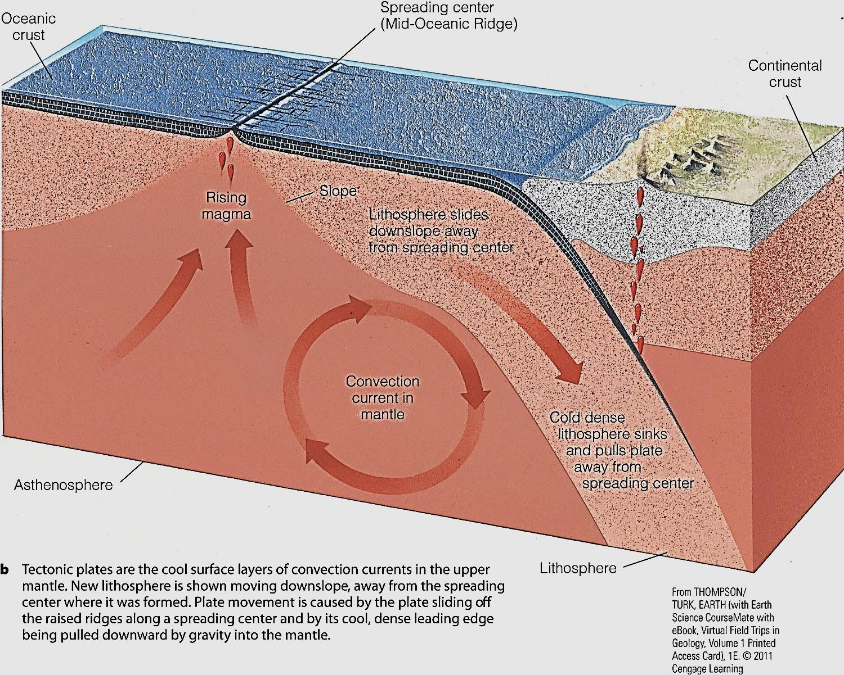
Figure 3-12b p82
Notes:
Figure 3.12
Convection.

Slide 20
Geographic Distribution of Earthquakes
0–70 km
70–300 km
> 300 km
Fig. 3-14, p. 84
Fig. 3-16, p. 78
Notes:
Figure 3.14: Seismic events worldwide, January 1977 through December 1986. The locations of about 10,000 earthquakes are colored red, green, and blue to represent event depths of 0–70 kilometers, 70–300 kilometers, and below 300 kilometers, respectively.

Slide 21
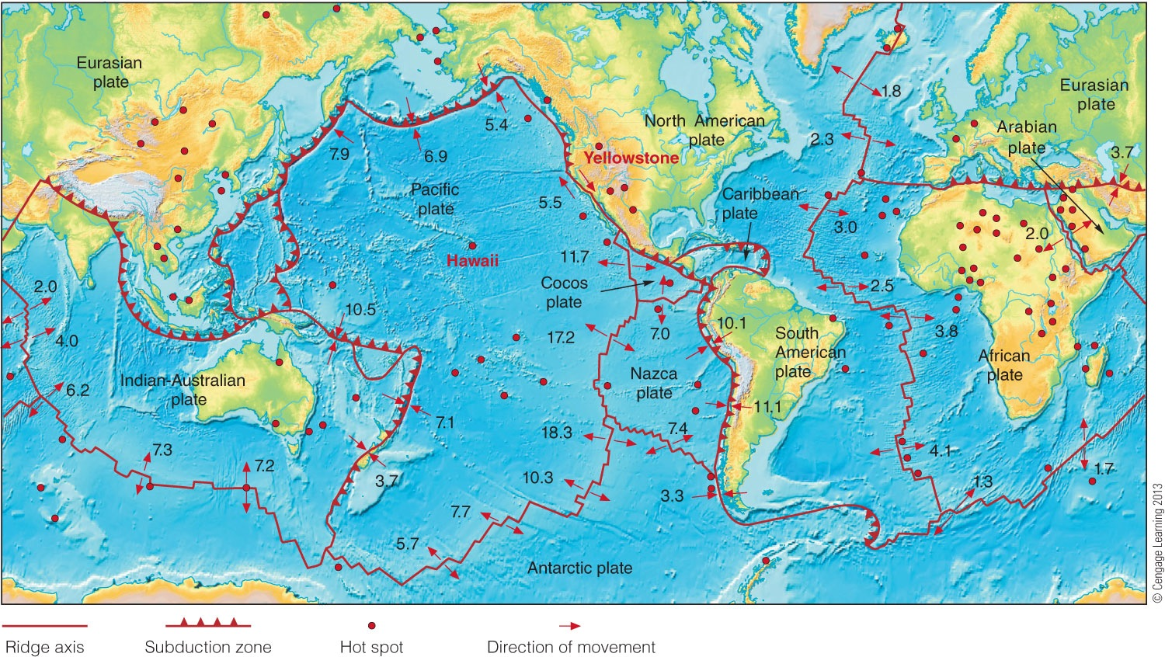
Earthquake Belts = Plate Boundaries
Fig. 3-17, p. 79
Figure 3-15 p85
Notes:
Figure 3.15 The major lithospheric plates, showing their directions of relative movement and the location
of the principal hot spots. Note the correspondence of plate boundaries and earthquake locations (compare
with Figure 3.14). Most of the million or so earthquakes and volcanic events each year occur along plate
boundaries. For more detail, please see this book’s opening endpaper.

Slide 22
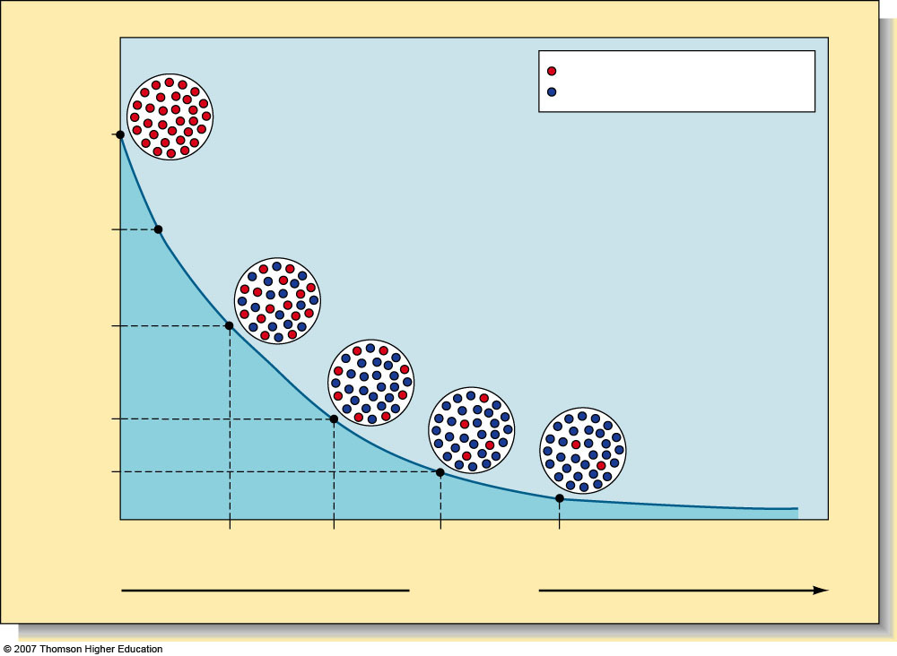
Uranium 238 (radioactive) Lead 206 (decay product)
100.0
Newly formed mineral
75.0
Percentage of remaining uranium 238 atoms
50.0
25.0
12.5
1 half-life 4.5
2 half-lives 9.0
3 half-lives 13.5
4 half-lives 18.0
billion years
Increasing time
Box 3-1, p. 77, 71
Notes:
The rate of radioactive decay of a radioactive form of uranium (²³⁸U) into lead. The half life of ²³⁸U is 45 billion years. During each half-life, one-half of the remaining amount of the radioactive element decays to become a different element. The assumption is made that the system has remained closed—no radioactive atoms or decay products have been added or removed from the sample. Ages obtained from absolute and relative dating of continental rocks and seabed rocks and sediments coincide with ages predicted by the theory of plate tectonics.

Slide 23
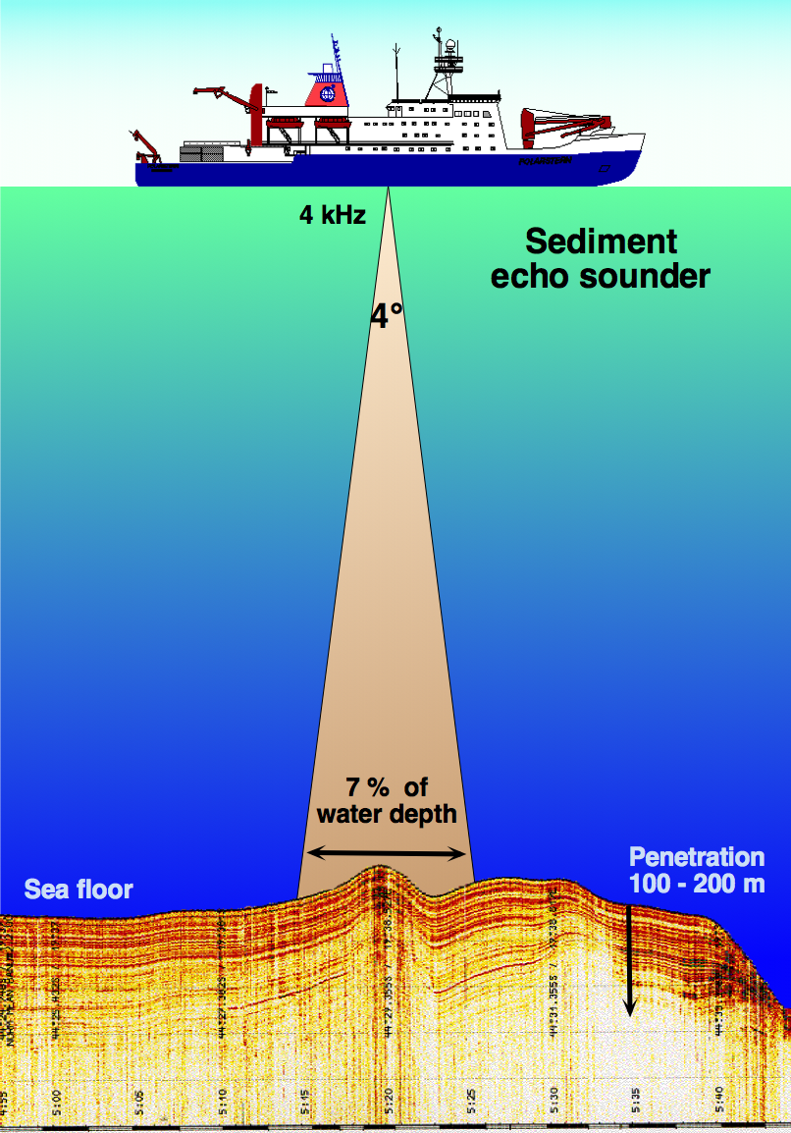

Slide 24
Atlantic cross section

Slide 25
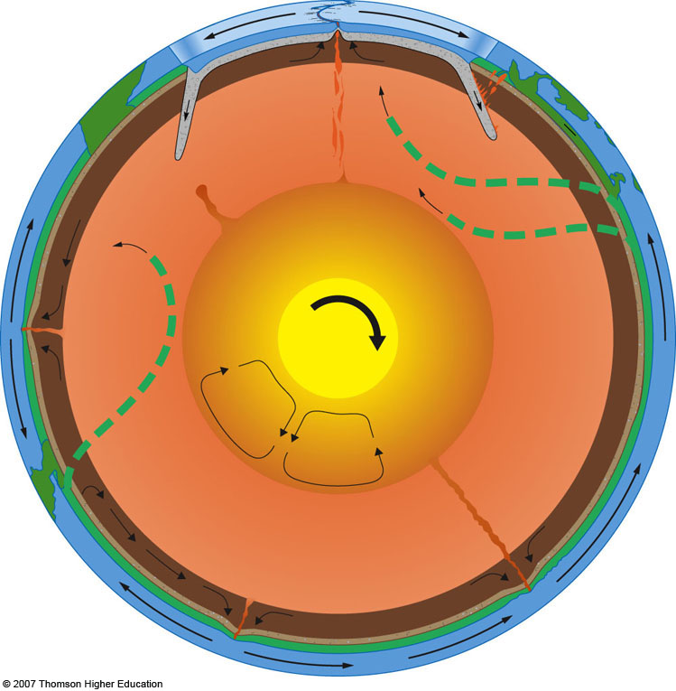
Convergent plate boundary marked by trench
Divergent plate boundary marked by mid-ocean ridge (spreading center)
Transform fault
Oceanic lithosphere
Asthenosphere
Subduction fueling volcanoes
Asia
Africa
Descending plate pulled down by gravity
Mantle upwelling
Superplume
Philippine Trench
Outer core
Mariana Trench
Mantle
Mid-Atlantic Ridge
Inner core
Rapid convection
at hot
spots
Hot
Cold
Possible
convection cells
South America
Peru–Chile Trench
Hawaii
East
Pacific Rise
Fig. 3-13, p. 73
Notes:
Figure 3.13: The tectonic system is powered by heat. Some parts of the mantle are warmer than others, and convection currents form when warm mantle material rises and cool material falls. Above the mantle floats the cool, rigid, lithosphere, which is fragmented into plates. Plate movement is powered by gravity: The plates slide down the ridges at the places of their formation; their dense, cool leading edges are pulled back into the mantle. Plates may move away from one another (along the ocean ridges), toward one another (at subduction zones or areas of mountain building), or past one another (as at California’s San Andreas Fault). Smaller localized convection currents form cylindrical plumes that rise to the surface to form hot spots (like the Hawai’ian Islands). Note that the whole mantle is involved in thermal convection currents.

Slide 26
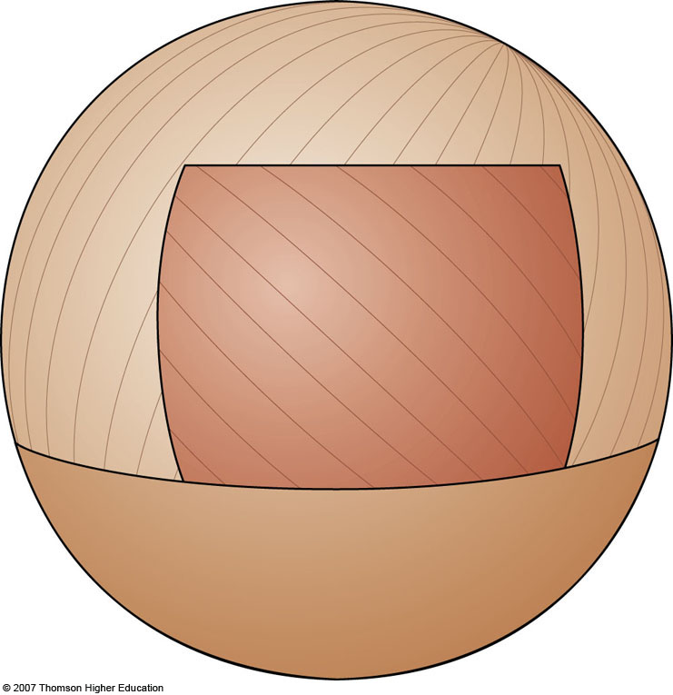
Plate B
Plate A
Plate C
Fig. 3-17a, p. 78, 9th
Fig. 3-16a, p. 86, 8th
Fig 3.18a, p. 80 7th
Notes:
Figure 3.16: Plate boundaries in action.
(a) Imagine a sphere composed of three plates.

Slide 27
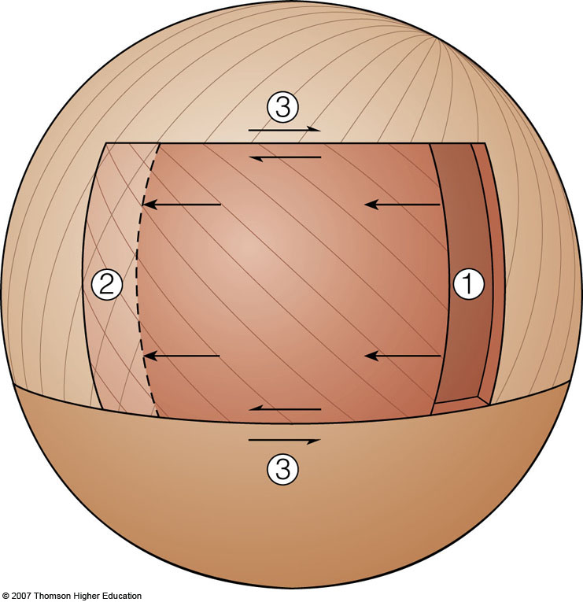
Plate B
Sliding: transform plate boundary
Overlap: convergent plate boundary
Plate A
Gap: divergent plate boundary
Plate C
Fig. 3-17b, p. 78, 9th
Fig. 3-16a, p. 86, 8th
Fig 3.18ab p. 80 7th
Notes:
Figure 3.16: Plate boundaries in action.
(b) As Plate A moves to the left (west), a gap forms behind it (1), and an overlap with Plate B forms in front (2). Sliding occurs along the top and bottom sides (3). The margins of Plate A experience the three types of interactions: at (1), extension characteristic of divergent boundaries; at (2), compression characteristic of convergent boundaries; and at (3), the shear characteristic of transform plate boundaries.

Slide 28
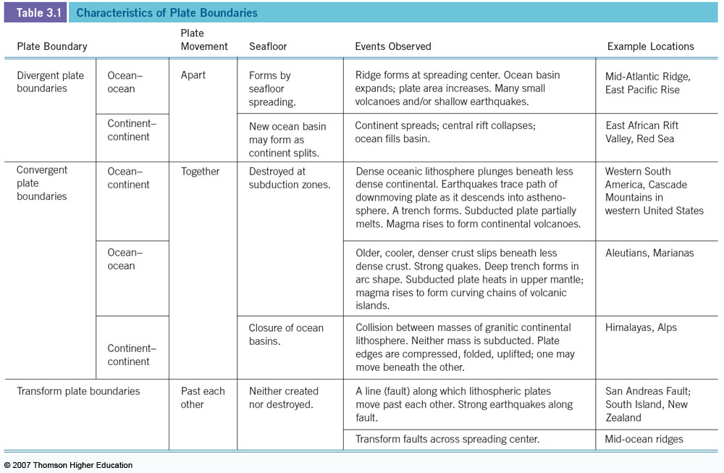
Table 3-1

Slide 29
Table 3-1

Slide 30
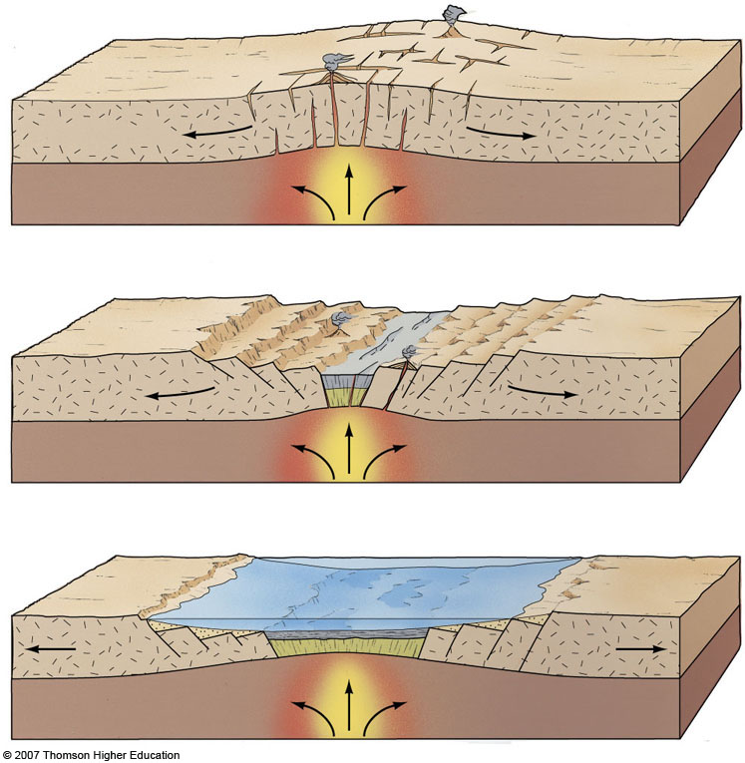
Warping, stretching of East Africa
Continental crust
Formation of rift valley
Red Sea
Fig. 3-18, p. 80, 9th
Fig. 3-17a-c, p. 76, p. 88
Fig. 3-19a-c, p. 82
Notes:
Figure 3.17: A model for the formation of a new plate boundary. The breakup of East Africa and the formation of the Red Sea began only about 25 million years ago.
(a) As the lithosphere began to crack, a rift formed beneath the continent, and molten basalt from the asthenosphere began to rise. (b) As the rift continued to open, the two new continents were separated by a growing ocean basin. Volcanoes and earthquakes occurred along the active rift area, which is now the mid-ocean ridge. The East African Rift Valley, although not yet submerged, currently resembles this stage (see Figure 3.18). (c) A new ocean basin (shown in green) forms beneath a new ocean.

Slide 31
LIFTS & WARPS CONTINENT
Continental crust
MANTLE PLUME
OR
THERMAL BULDGE
Notes:
Figure 3.17: A model for the formation of a new plate boundary. The breakup of East Africa and the formation of the Red Sea began only about 25 million years ago.
(a) As the lithosphere began to crack, a rift formed beneath the continent, and molten basalt from the asthenosphere began to rise. (b) As the rift continued to open, the two new continents were separated by a growing ocean basin. Volcanoes and earthquakes occurred along the active rift area, which is now the mid-ocean ridge. The East African Rift Valley, although not yet submerged, currently resembles this stage (see Figure 3.18). (c) A new ocean basin (shown in green) forms beneath a new ocean.

Slide 32
Stretching & thinning forms rift valley
Decompression melting
fills rift with basalt
Notes:
Figure 3.17: A model for the formation of a new plate boundary. The breakup of East Africa and the formation of the Red Sea began only about 25 million years ago.
(a) As the lithosphere began to crack, a rift formed beneath the continent, and molten basalt from the asthenosphere began to rise. (b) As the rift continued to open, the two new continents were separated by a growing ocean basin. Volcanoes and earthquakes occurred along the active rift area, which is now the mid-ocean ridge. The East African Rift Valley, although not yet submerged, currently resembles this stage (see Figure 3.18). (c) A new ocean basin (shown in green) forms beneath a new ocean.

Slide 33
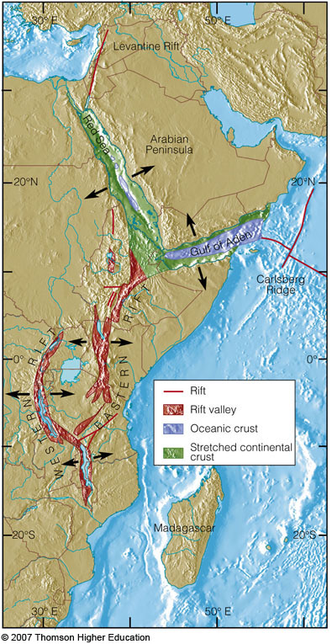
Fig. 3-19, p. 82, 9th
Fig. 3-18, p. 90
Fig. 3-20, p. 83
Notes:
Figure 3.18: The East African rift system, a divergent boundary. East Africa is being pulled apart by tectonic forces thought to be driven by a superplume originating at the core–mantle boundary (see again Figure 3.13). The lithosphere in this region is relatively thin, and as the upward arching lithosphere cracks and splits, long linear blocks have fallen along faults. Some of these blocks are overlain by freshwater lakes; some are dry and occasionally below sea level. Oceanic crust has been generated in the area to the north (the Red Sea, the Gulf of Aden) for about 5 million years—these are the freshest bits of a new ocean-to-be.

Slide 34
p. 82, 88,80
Notes:
Figure 3.17: A model for the formation of a new plate boundary. The breakup of East Africa and the formation of the Red Sea began only about 25 million years ago.
(d) The Red Sea. Note the remarkable sawtooth configuration of the peaks on the horizon and their similarity to the diagram.

Slide 35
p. 82, 88,80
Notes:
Figure 3.17: A model for the formation of a new plate boundary. The breakup of East Africa and the formation of the Red Sea began only about 25 million years ago.
(d) The Red Sea. Note the remarkable sawtooth configuration of the peaks on the horizon and their similarity to the diagram.

Slide 36
Fig. 3-19, p. 82, 9th
Fig. 3-18, p. 90
Fig. 3-20, p. 83
Notes:
Figure 3.18: The East African rift system, a divergent boundary. East Africa is being pulled apart by tectonic forces thought to be driven by a superplume originating at the core–mantle boundary (see again Figure 3.13). The lithosphere in this region is relatively thin, and as the upward arching lithosphere cracks and splits, long linear blocks have fallen along faults. Some of these blocks are overlain by freshwater lakes; some are dry and occasionally below sea level. Oceanic crust has been generated in the area to the north (the Red Sea, the Gulf of Aden) for about 5 million years—these are the freshest bits of a new ocean-to-be.

Slide 37
Spreading, cooling and isostatic subsidence forms linear sea
Red Sea
Notes:
Figure 3.17: A model for the formation of a new plate boundary. The breakup of East Africa and the formation of the Red Sea began only about 25 million years ago.
(a) As the lithosphere began to crack, a rift formed beneath the continent, and molten basalt from the asthenosphere began to rise. (b) As the rift continued to open, the two new continents were separated by a growing ocean basin. Volcanoes and earthquakes occurred along the active rift area, which is now the mid-ocean ridge. The East African Rift Valley, although not yet submerged, currently resembles this stage (see Figure 3.18). (c) A new ocean basin (shown in green) forms beneath a new ocean.

Slide 38
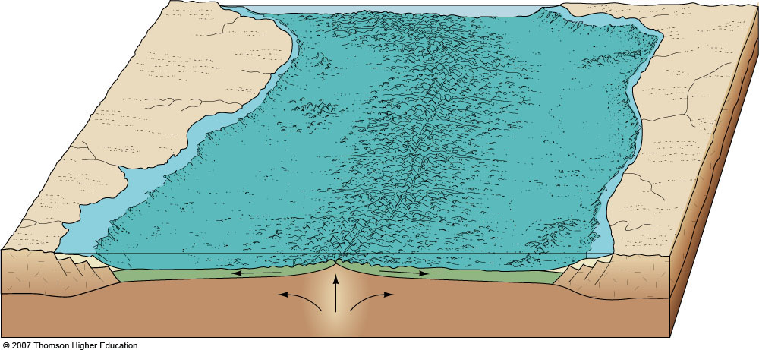
@ ~ 30-50 my mid-ocean ridge forms
South America
Rift
Atlantic
Africa
Oceanic crust
Continental crust
p. 84, 91, 83
Notes:
Figure 3.19: The Mid-Atlantic Ridge, showing its conformance to the coastlines of the adjacent continents. The first inset shows a detail of the ridge generated from side-scan sonar data—the central rift is clearly visible. Red and orange colors indicate the crest of the ridge; dark blue, the deeper seabed on either side. The second insert shows the location of the ridge and associated valley in the Atlantic.

Slide 39
Forming a Divergent Boundary
Notes:
To view this animation, click “View” and then “Slide Show” on the top navigation bar.

Slide 40
Table 3-1,

Slide 41
Table 3-1

Slide 42
Table 3-1

Slide 43
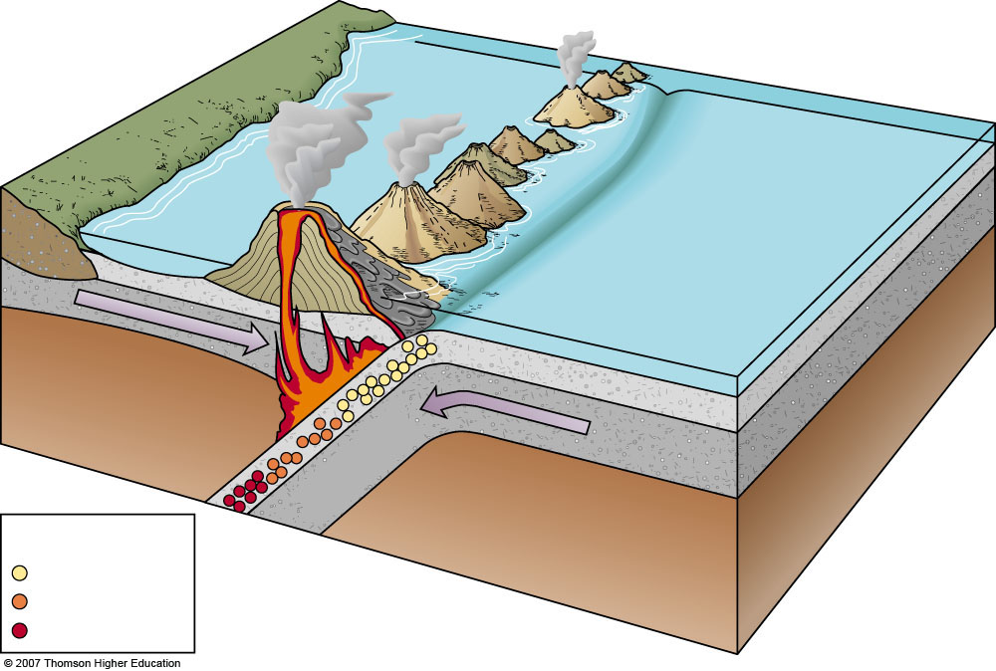
Marginal sea
Volcanic arc
Trench
Continental
Oceanic
crust
Oceanic crust
lithosphere
Magma
Earthquake focus
Wadati–
Benioff zone
Key
Shallow
Intermediate
Fig. 3-23a, p. 86, 9th
Fig. 3-25a, p. 86
Fig. 3-23a, p. 81
Fig. 3-22a, p. 94
Deep
Notes:
Figure 3.23a: The formation of an island arc along a trench as two oceanic plates converge. The volcanic islands form as masses of magma reach the seafloor. The Japanese islands were formed in this way.

Slide 44
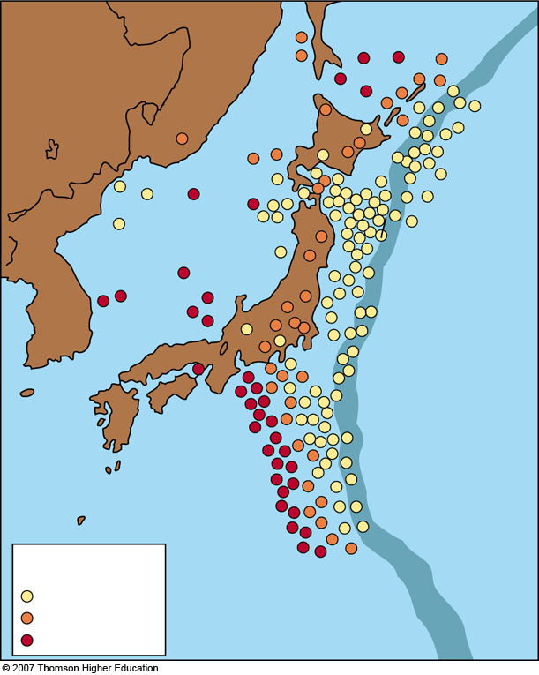
Russia
China
Japan
Korea
Japan Trench
Kobe 1995
Key
Shallow
Intermediate
Deep
Notes:
Figure 3.23b: The distribution of shallow, intermediate, and deep earthquakes for part of the Pacific Ring of Fire in the vicinity of the Japan Trench. Note that earthquakes occur on only one side of the trench, the side on which the plate subducts. The great Indonesian tsunami of 2005 was caused by these forces; the site of the catastrophic 1995 Kobe subduction earthquake is marked.

Slide 45
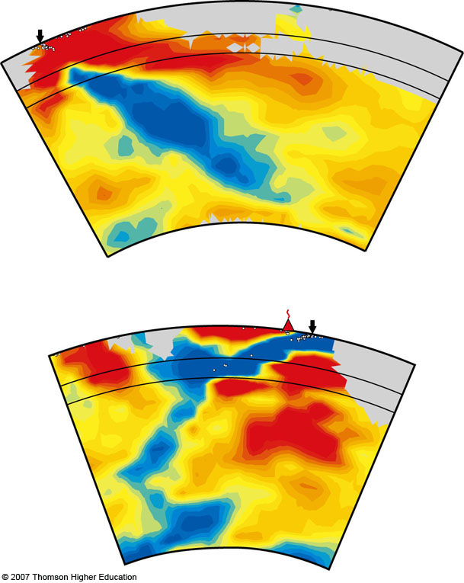
W
Trench
E
JAPAN
Core–mantle boundary
p. 86, 80, 93
Notes:
Figure 3.22: Vertical slices through Earth’s mantle beneath Central America and Japan showing the distribution of warmer (red) and colder (blue) material. The configuration of colder material suggests that the subducting slabs beneath both areas have penetrated to the core–mantle boundary, which is at a depth of about 2,900 kilometers (1,800 miles).

Slide 46
Marginal sea
Volcanic arc
Trench
Continental
Oceanic
crust
Oceanic crust
lithosphere
Magma
Earthquake focus
Wadati–
Benioff zone
Key
Shallow
Intermediate
Deep
Notes:
Figure 3.23a: The formation of an island arc along a trench as two oceanic plates converge. The volcanic islands form as masses of magma reach the seafloor. The Japanese islands were formed in this way.

Slide 47
Table 3-1

Slide 48
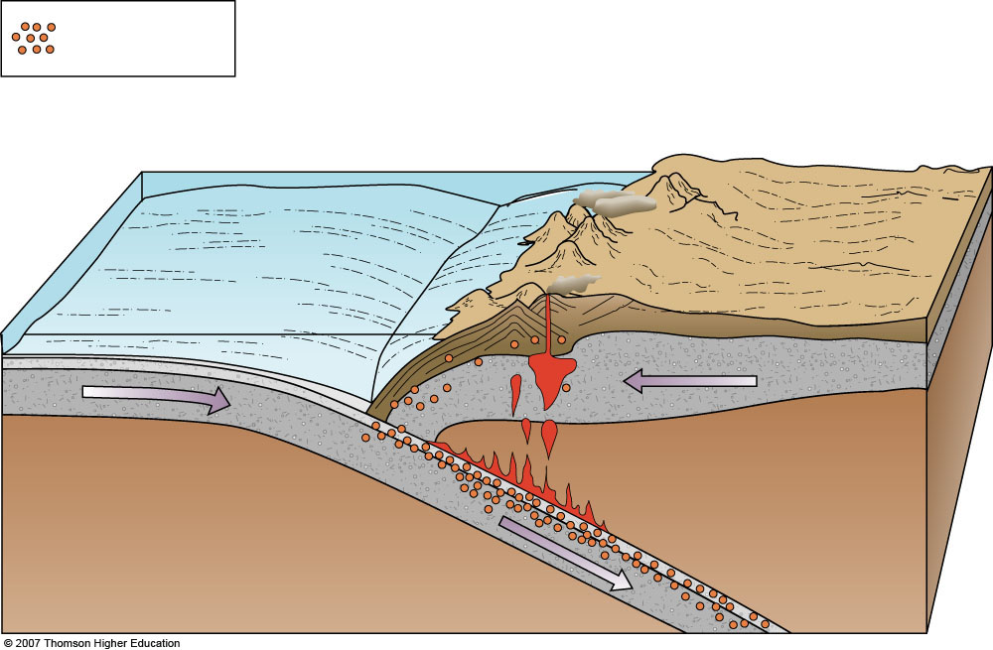
Earthquake locations
Peru–Chile Trench
Andes: Volcanic mountains
South America: Continental lithosphere
Oceanic lithosphere
Gently descending slab
Fig. 3-22a, p. 85, 9th
Fig. 3-23a, p. 86
Fig. 3-21, p. 80
Fig. 3-21a, p. 93
Notes:
Figure 3.21: A cross section through the west coast of South America showing the convergence of a continental plate and an oceanic plate. The subducting oceanic plate becomes denser as it descends, its downward slide propelled by gravity. Starting at a depth of about 100 kilometers (60 miles), heat drives water and other volatile components from the subducted sediments into the overlying mantle, lowering its melting point. Masses of the melted material, rich in water and carbon dioxide, rise to power Andean volcanoes.

Slide 49
CENTRAL AMERICA
W
Trench
E
Core–mantle boundary
Notes:
Figure 3.22: Vertical slices through Earth’s mantle beneath Central America and Japan showing the distribution of warmer (red) and colder (blue) material. The configuration of colder material suggests that the subducting slabs beneath both areas have penetrated to the core–mantle boundary, which is at a depth of about 2,900 kilometers (1,800 miles).

Slide 50
Earthquake locations
Peru–Chile Trench
Andes: Volcanic mountains
South America: Continental lithosphere
Oceanic lithosphere
Gently descending slab
Notes:
Figure 3.21: A cross section through the west coast of South America showing the convergence of a continental plate and an oceanic plate. The subducting oceanic plate becomes denser as it descends, its downward slide propelled by gravity. Starting at a depth of about 100 kilometers (60 miles), heat drives water and other volatile components from the subducted sediments into the overlying mantle, lowering its melting point. Masses of the melted material, rich in water and carbon dioxide, rise to power Andean volcanoes.

Slide 51
Table 3-1

Slide 52
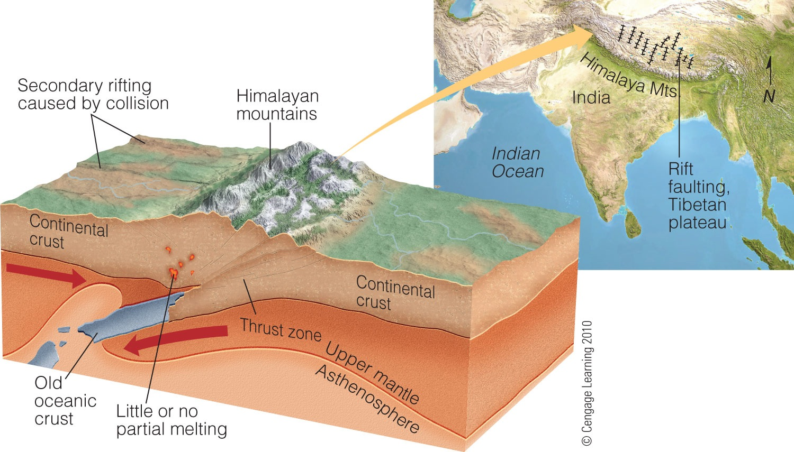
Fig. 3-24, p. 86, 9th
Fig. 3-26, p. 87
Fig. 3-24, p. 81
Fig. 3-23, p. 94

Slide 53
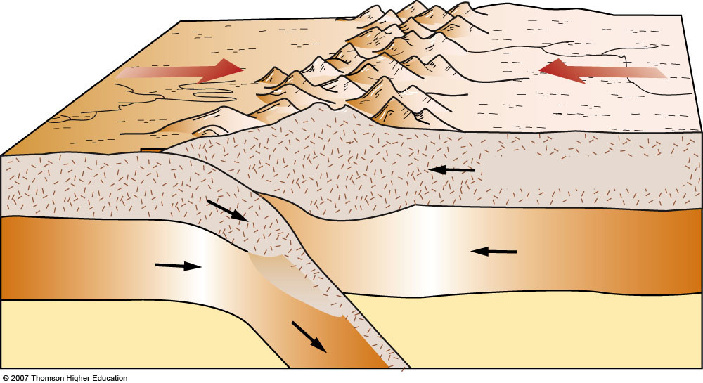
Mountain range
High plateau
Continental crust
Lithosphere
Asthenosphere
Ancient oceanic crust
Fig. 3-24, p. 86, 9th
Fig. 3-26, p. 87
Fig. 3-24, p. 81
Fig. 3-23, p. 94
Notes:
Figure 3.24: A cross section through southern China, showing the convergence of two continental plates. Collision of continental plates generally occurs after subduction of oceanic crust. Neither plate is dense enough to subduct; instead, their compression thickened and uplifted the plate edges to form the Himalayas. Notice the supporting “root” beneath the emergent mountain needed for isostatic equilibrium.

Slide 54
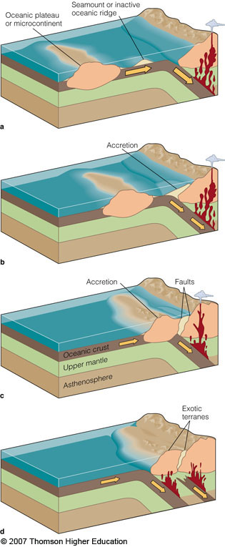
Fig. 3-32, p. 96, 9th
p. 97, 90, 106
Notes:
Figure 3.34: Terrane formation. Oceanic plateaus usually composed of relatively low-density rock are not subducted into the trench with the oceanic plate. Instead, they are “scraped off,” causing uplifting and mountain building as they strike a continent (a–d). Though rare, assemblages of subducting oceanic lithosphere known as ophiolites can also be scraped off (obducted) onto the edges of continents.

Slide 55
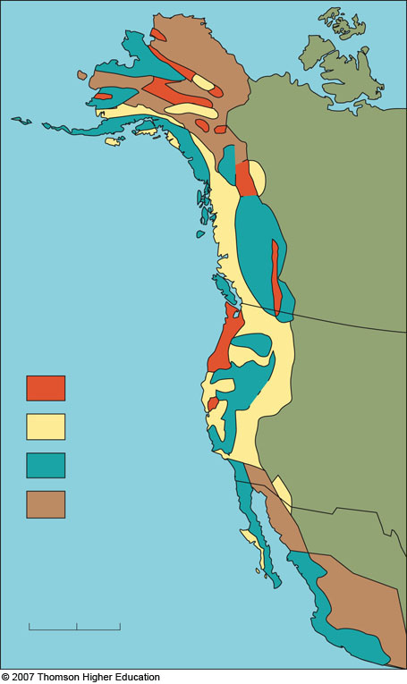
Wrangellia Terrane
Canada
Accreted terranes
United States
Island arc
Sonoma Terrane
North American Craton
Submarine deposits
Ancient ocean floor
United States
Displaced continental fragments
Mexico
0
600
km
Notes:
Figure 3.35: North American terranes. These fragments have differing histories and origins. Some have moved thousands of kilometers to be scraped off onto the North American core as their transporting plate subducted.

Slide 56
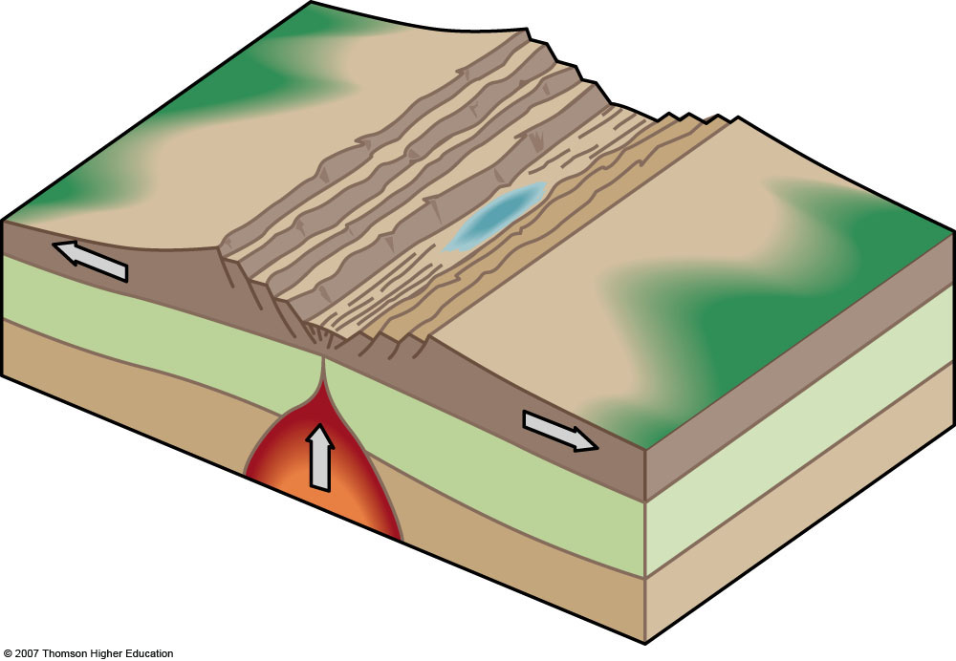
Stage 1: Embryonic
Motion: Rift flank uplift, rift valley subsidence
Features: Complex system of rift valleys and lakes on continent
Example: East African Rift Valley
Fig. 3-24, p. 86, 9th
Notes:
Figure 3.37: The Wilson cycle, named in honor of John Tuzo Wilson’s synthesis of plate tectonics. Over great spans of time, ocean floors form and are destroyed. Mountains erode, sediments subduct, and continents rebuild. Seawater moves from basin to basin.

Slide 57
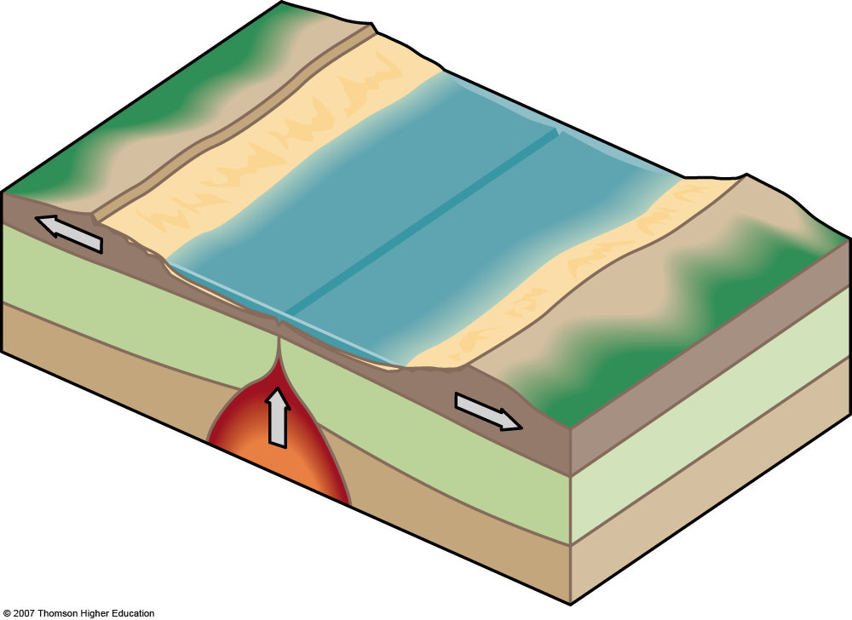
Stage 2: Juvenile
Motion: Divergence (spreading)
Features: Narrow sea with matching coasts. Oceanic ridge formed.
Example : Red Sea
Notes:
Figure 3.37: The Wilson cycle, named in honor of John Tuzo Wilson’s synthesis of plate tectonics. Over great spans of time, ocean floors form and are destroyed. Mountains erode, sediments subduct, and continents rebuild. Seawater moves from basin to basin.

Slide 58
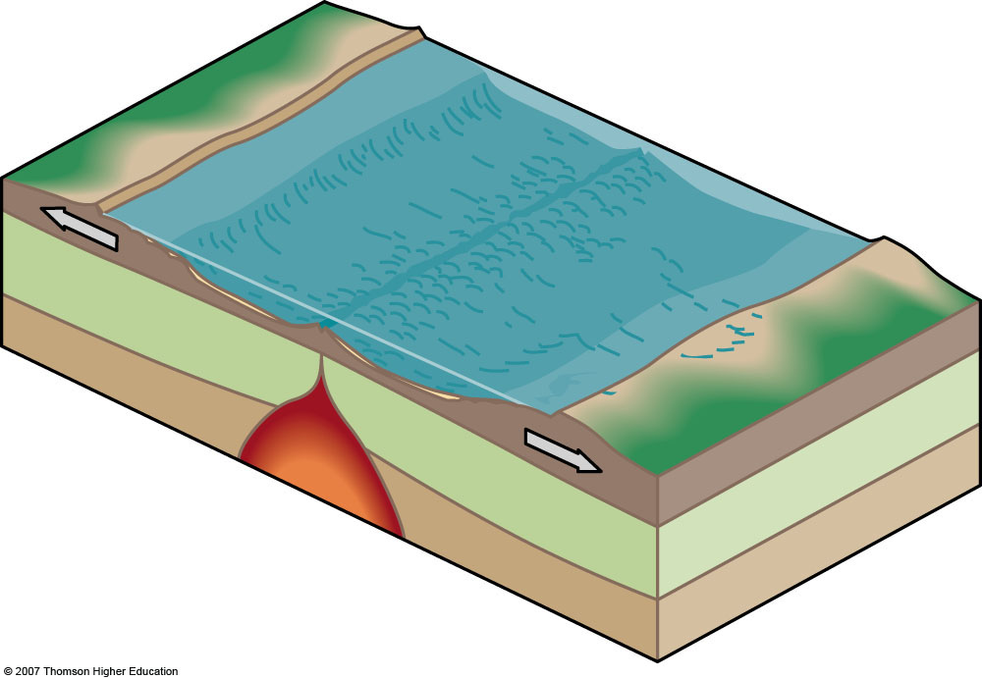
Stage 3: Mature
Motion: Divergence (spreading)
Features: Ocean basin with continental margins. Ocean continues to widen at oceanic ridge.
Example: Atlantic Ocean, Arctic Ocean
Notes:
Figure 3.37: The Wilson cycle, named in honor of John Tuzo Wilson’s synthesis of plate tectonics. Over great spans of time, ocean floors form and are destroyed. Mountains erode, sediments subduct, and continents rebuild. Seawater moves from basin to basin.

Slide 59
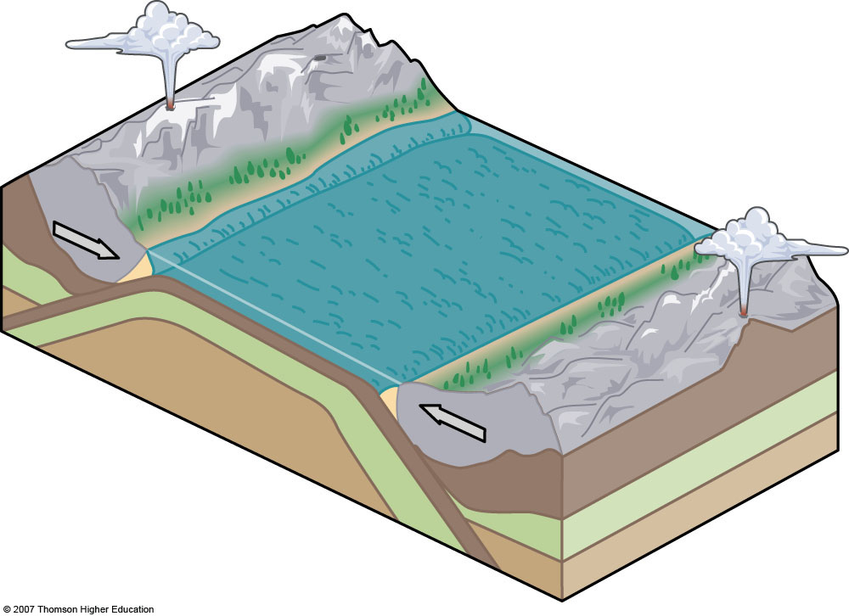
Stage 4: Declining
Motion: Convergence (subduction)
Features: Subduction begins. Island arcs and trenches form around basin edge.
Example: Pacific Ocean
Notes:
Figure 3.37: The Wilson cycle, named in honor of John Tuzo Wilson’s synthesis of plate tectonics. Over great spans of time, ocean floors form and are destroyed. Mountains erode, sediments subduct, and continents rebuild. Seawater moves from basin to basin.

Slide 60
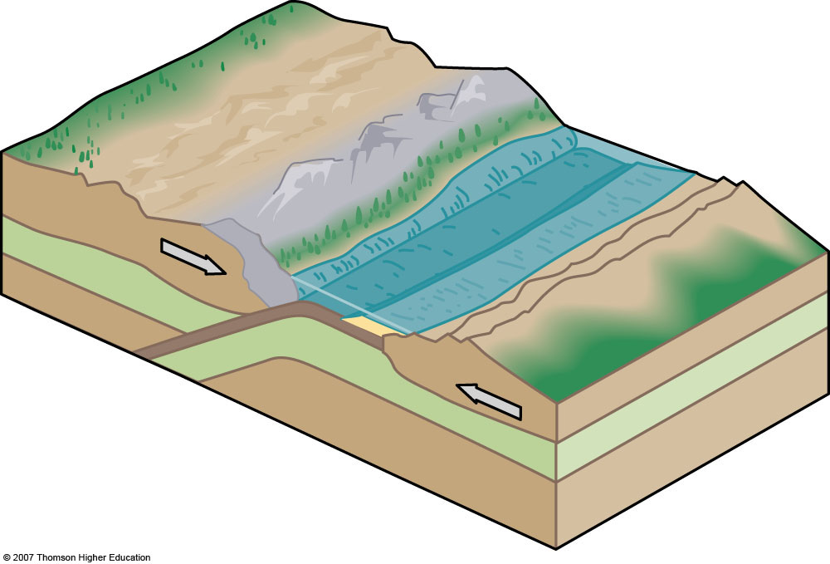
Stage 5: Terminal
Motion: Convergence, collision, and uplift
Features: Oceanic ridge subducted. Narrow, irregular seas with young mountains.
Example: Mediterranean Sea
Notes:
Figure 3.37: The Wilson cycle, named in honor of John Tuzo Wilson’s synthesis of plate tectonics. Over great spans of time, ocean floors form and are destroyed. Mountains erode, sediments subduct, and continents rebuild. Seawater moves from basin to basin.

Slide 61
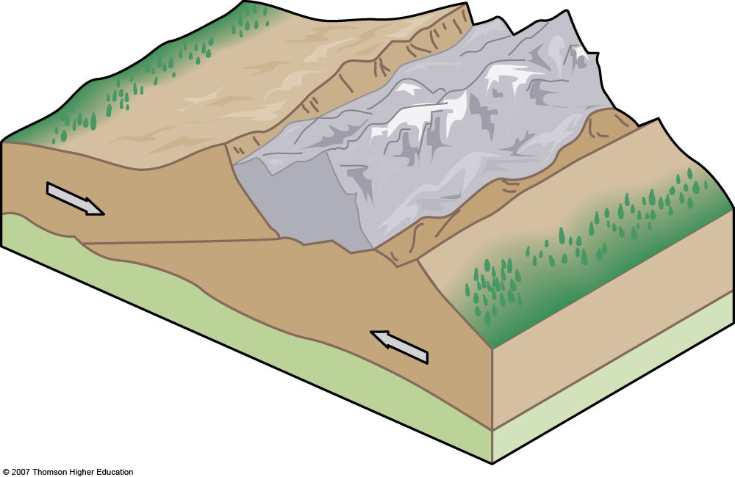
Stage 6: Suturing
Motion: Convergence and uplift
Features: Mountains form as two continental crust masses collide, are compressed, and override.
Example: India – Eurasia collision, Himalayas
Notes:
Figure 3.37: The Wilson cycle, named in honor of John Tuzo Wilson’s synthesis of plate tectonics. Over great spans of time, ocean floors form and are destroyed. Mountains erode, sediments subduct, and continents rebuild. Seawater moves from basin to basin.

Slide 62
Table 3-1

Slide 63
Table 3-1

Slide 64
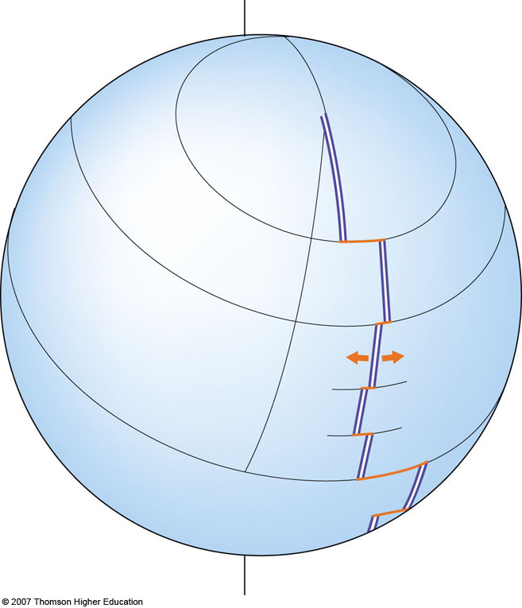
Axis of
Earth’s rotation
Axis of
plate rotation
Fig. 3-25, p. 87, 9th
p. 88, 95
Notes:
Figure 3.25a: Transform faults (orange) form because the axis of seafloor spreading on the surface of a sphere cannot follow a smoothly curving line. The motion of two diverging lithospheric plates (arrows) rotates about an imaginary axis extending through Earth.

Slide 66
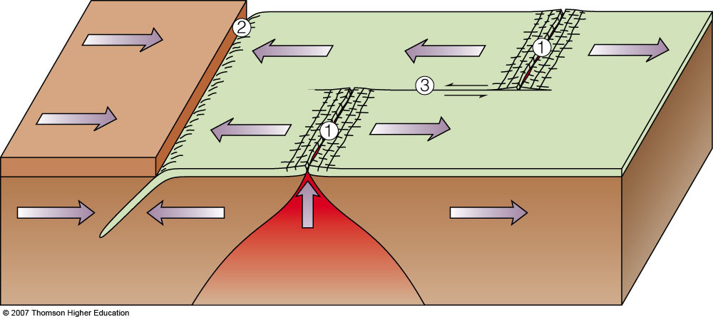
Divergent boundary (constructive)
Trench
Convergent boundary (destructive)
Transform boundary (conservative)
1
Rising magma
Asthenosphere
Fig. 3-17, p. 78, 9th
p. 80, 91
Notes:
Figure 3.16: Plate boundaries in action.
(c) Plate boundaries on the surface of a sphere. The divergent (1), convergent (2), and transform (3) margins match those of the margins of Plate A in (b).

Slide 67
Motion at Transform Boundaries
Notes:
To view this animation, click “View” and then “Slide Show” on the top navigation bar.

Slide 68
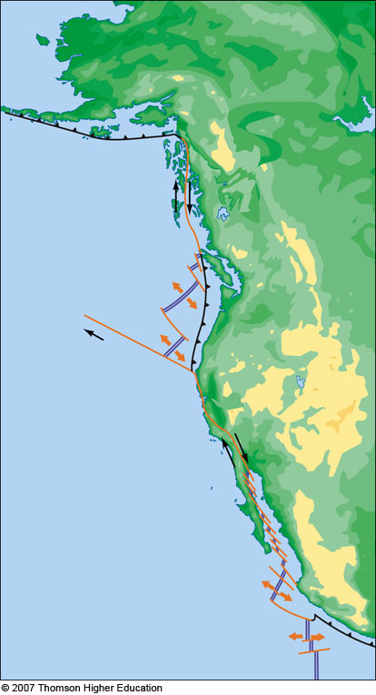
Alaska
Aleutian Trench
Queen Charlotte Fault
Canada
Juan de Fuca Ridge
Cascadian Subduction Zone
NORTH AMERICAN PLATE
Mendocino Fracture Zone
San Andreas Fault
Gulf of California
Mexico
PACIFIC PLATE
Rivera Fault
East Pacific Rise
COCOS PLATE
Fig. 3-25b, p. 87, 9th
p.88, 82, 95
Notes:
Figure 3.25b: A long transform plate boundary, which includes California’s San Andreas Fault. Note the offset plate boundaries caused by divergence on a sphere.

Slide 69
Table 3.1

Slide 70
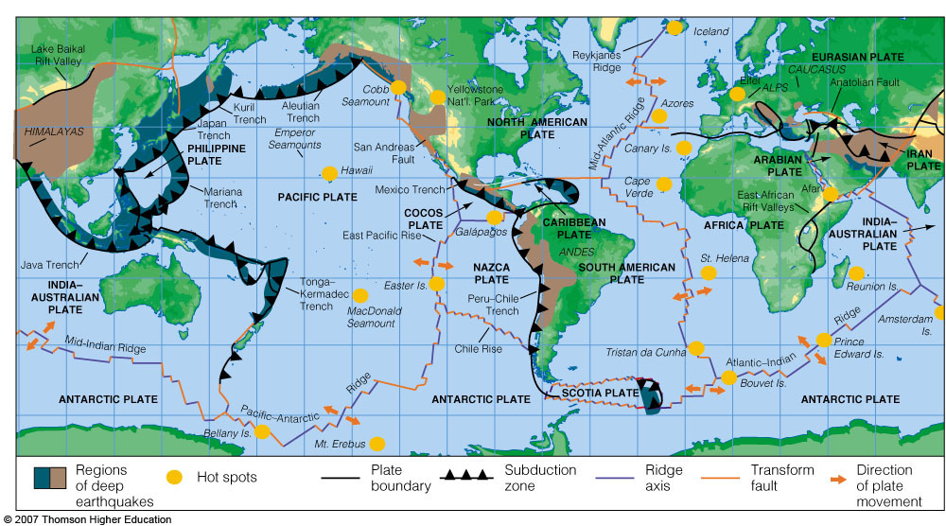
Fig. 3-16, p. 77, 9th
p. 79, 74, 85
Notes:
Figure 3.15: The major lithospheric plates, showing their directions of relative movement and the location of the principal hot spots. Note the correspondence of plate boundaries and earthquake locations—compare this figure to Figure 3.14. Most of the million or so earthquakes and volcanic events each year occur along plate boundaries.

Slide 71
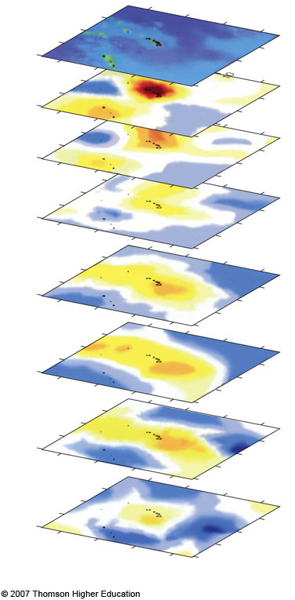
170
160
150
140
30
Depth
km
20
Depth
mi
10
0
186
300
650
403
1,000
620
1,450
899
1,900
1,178
2,350
1,457
1,736
2,800
30
170
160
20
150
10
Degrees North Latitude
140
0
West Longitude
p.94, 88, 103
Notes:
Figure 3.31: Imaging a mantle plume by individual slices down to the core–mantle boundary. Maps of P-wave velocity perturbations at different depths beneath the Hawai’ian Islands show a vast area of unusually high temperature (red and yellow areas) that extends up from the core–mantle boundary (about 2,800 kilometers from the surface). This area of high temperature is a mantle plume. Activity atop this plume powers the Hawai’ian volcanoes, and plumes like this are thought to bring to the asthenosphere much of the heat needed to power plate tectonics. The position of the Hawai’ian Islands is shown on each slice for orientation, but, of course, the islands are only at Earth’s surface.

Slide 72
Convection and Tectonics
Notes:
To view this animation, click “View” and then “Slide Show” on the top navigation bar.

Slide 73
Convection in a Lava Lamp
Notes:
To view this animation, click “View” and then “Slide Show” on the top navigation bar.

Slide 74
Hot Spot Volcano Tracks
Notes:
To view this animation, click “View” and then “Slide Show” on the top navigation bar.

Slide 75
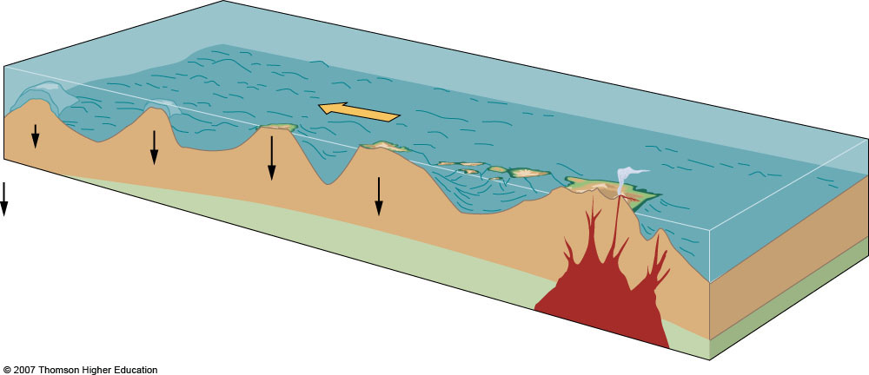
Plate motion
Mauna Kea
Mauna Loa
Lithosphere
Kilauea
Isostatic sinking
Loihi
Fig. 3-30, p. 93, 9th
Fig. 3-32, p. 89
Fig. 3-29, p. 103
Notes:
Figure 3.32: Formation of a volcanic island chain as an oceanic plate moves over a stationary mantle plume and hot spot. The age of the islands increases toward the left. New islands will continue to form over the hot spot. In this example, showing the formation of the Hawai’ian Islands, Loihi is such a newly forming island.

Slide 76
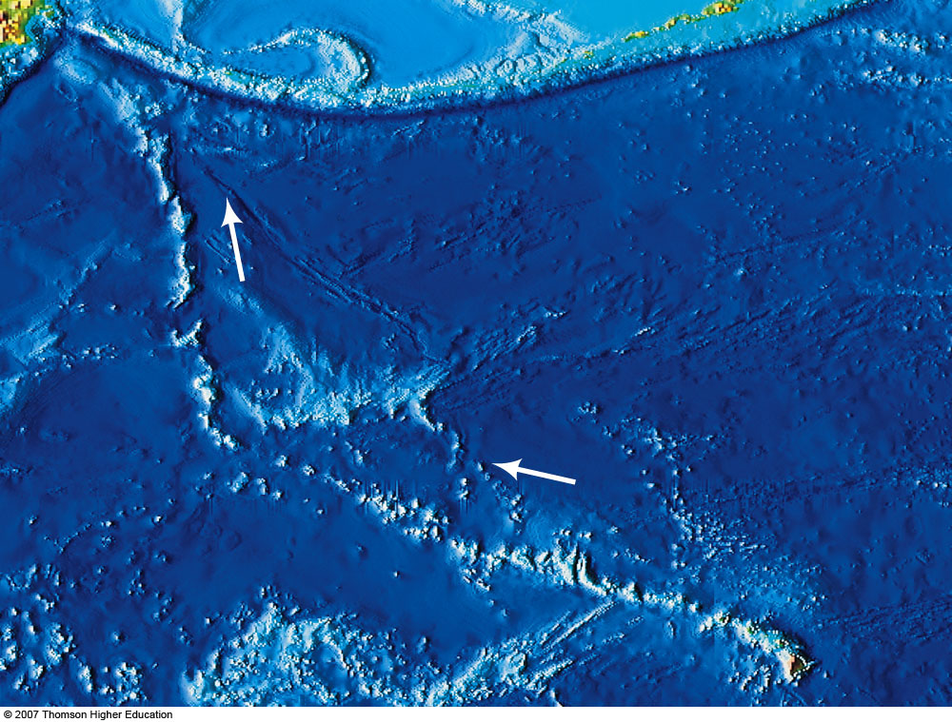
Meiji Seamount
70 Ma
Aleutian Islands
PACIFIC OCEAN
Emperor Seamounts
50 Ma
40 Ma
Hawaiian–Emperor Bend
30 Ma
20 Ma
10 Ma
Kauai 5 Ma
Hawaii <1 Ma
Hawaiian Ridge
Position of Loihi
Ma = million years ago
Fig. 3-33, p. 89 Fig. 3-29, p. 103
Notes:
Figure 3.33: The Hawai’ian chain, islands formed one by one as the Pacific Plate slid over a hot spot. The oldest known member of the chain, the Meiji Seamount, formed about 70 million years ago (Ma), and the bend in the chain shows that the plate changed direction about 40 Ma. The island of Hawai’i still has active volcanism, but the next island in the chain, Loihi, has begun building on the ocean floor. The upper arrow shows the initial direction of plate motion; the lower arrow shows the present direction.

Slide 77
Figure 15.18

Slide 78
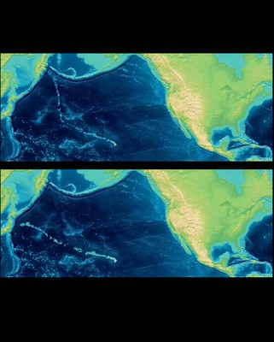

Slide 79
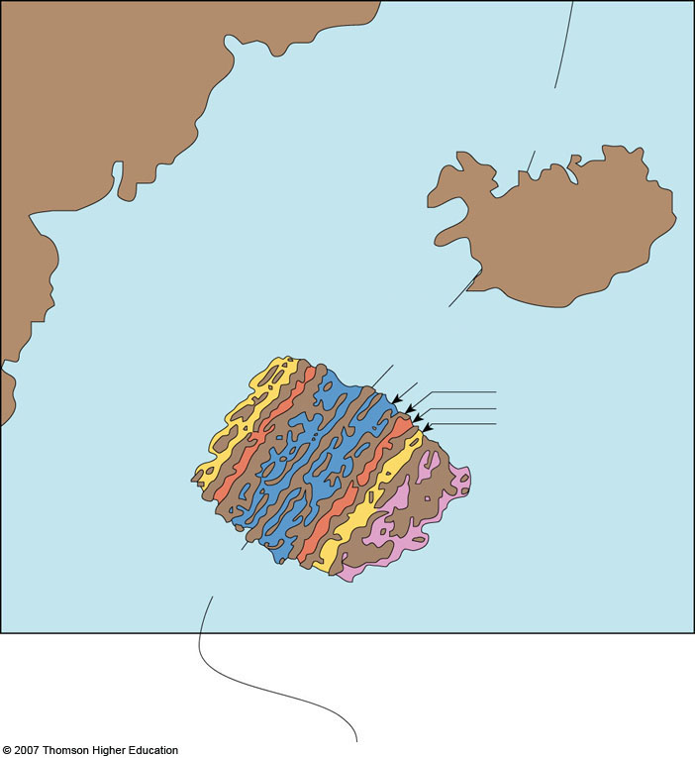
Greenland
Ridge
Atlantic Ocean
Iceland
Atlantic
3 Ma
6 Ma
9 Ma
15 Ma
Reversed field
Region of
magnetic survey
Normal field
Mid-
Fig. 3-28a, p. 85
Fig. 3-27, p. 99
Notes:
Figure 3.28: Patterns of paleomagnetism and their explanation by plate tectonic theory.
(a) When scientists conducted a magnetic survey of a spreading center, the Mid-Atlantic Ridge, they found bands of weaker and stronger magnetic fields locked in the rocks.

Slide 80
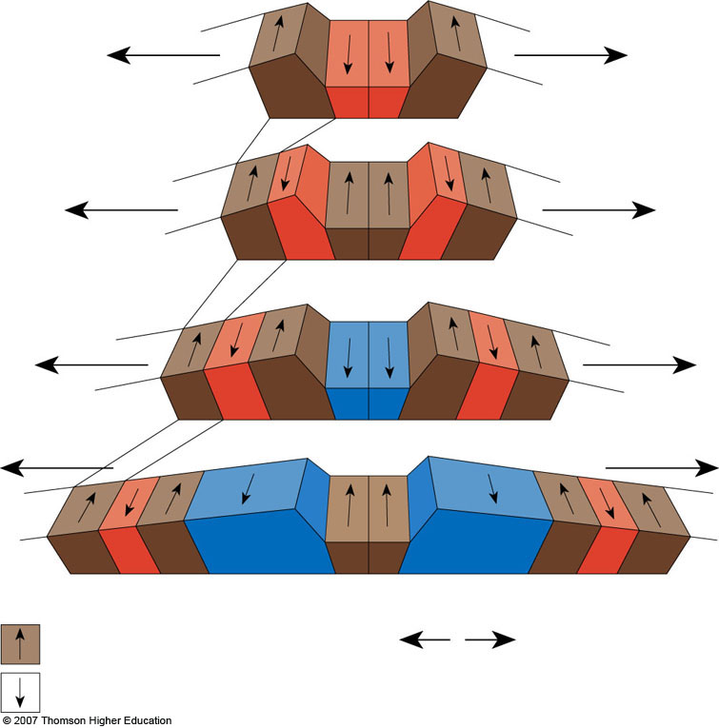
9 Ma
6 Ma
3 Ma
Today
= Normal magnetic polarity
= Direction of plate movement
= Reversed magnetic polarity
Ma = mega-annum, millions of years ago
Fig. 3-28a, p. 85
Fig. 3-27, p. 99
Notes:
Figure 3.28: Patterns of paleomagnetism and their explanation by plate tectonic theory.
(b) The molten rocks forming at the spreading center take on the polarity of the planet when they are cooling and then move slowly in both directions from the center. When Earth’s magnetic field reverses, the polarity of newly formed rocks changes, creating symmetrical bands of opposite polarity.

Slide 81
Figure 15.19

Slide 82
Seafloor Spreading and Seafloor Magnetization
Notes:
To view this animation, click “View” and then “Slide Show” on the top navigation bar.

Slide 83
Pleistocene to Recent (0–1.6 Ma)
Paleocene (58–66 Ma)
Ma = mega-annum, millions of years ago
Pliocene (1.6–5 Ma)
Late Cretaceous (66–88 Ma)
Miocene (5–24 Ma)
Middle Cretaceous (88–118 Ma)
Oligocene (24–37 Ma)
Early Cretaceous (118–144 Ma)
Eocene (37–58 Ma)
Late Jurassic (144–161 Ma)
Fig. 3-29, p. 86
Fig. 3-28, p. 101
Notes:
Figure 3.29: The age of the ocean floors. The colors represent an expression of seafloor spreading over the last 200 million years as revealed by paleomagnetic patterns. Note especially the relative symmetry of the Atlantic basin in contrast with the asymmetrical Pacific, where the spreading center is located close to the eastern margin and intersects the coast of California.

Slide 84
Chapter 15 Opening Figure

Slide 85
Motion at Plate Boundaries
Notes:
To view this animation, click “View” and then “Slide Show” on the top navigation bar.

Slide 86
Breakup of Pangaea
Notes:
To view this animation, click “View” and then “Slide Show” on the top navigation bar.

Slide 87
Motion at Plate Boundaries
Notes:
To view this animation, click “View” and then “Slide Show” on the top navigation bar.

Slide 88
Seafloor Spreading and Plate Boundaries
Notes:
To view this animation, click “View” and then “Slide Show” on the top navigation bar.

Slide 89
Convection in a Lava Lamp
Notes:
To view this animation, click “View” and then “Slide Show” on the top navigation bar.

